Slide 1

Graph Algorithms

Slide 2
Bio - Dr. Li Wang
Staff Software Engineer @ LinkedIn
Professor @ DeVry University
Ph.D in CS @ Illinois Institute of Technology, US
B.S & M.S in CS @ Chongqing University, China

Slide 3

Let’s Connect on LinkedIn!
https://www.linkedin.com/in/li-wang-67049615/

Slide 4
How to Solve Graph Interview Questions
Determine whether the problem can be modeled as a graph problem or not.
Graph and its representation (prerequisite)
What are the most common graph problems?
How to solve graph problems
Breadth-First Search (BFS)
Depth-First Search (DFS)
Topological Sort
Other algorithms
Dijkstra's Algorithm
Union Find
...

Slide 5
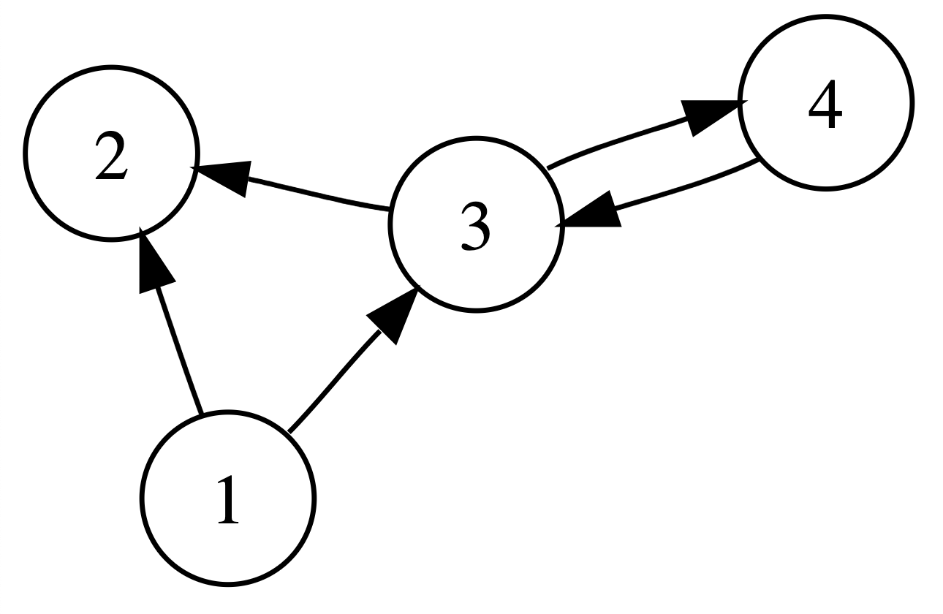
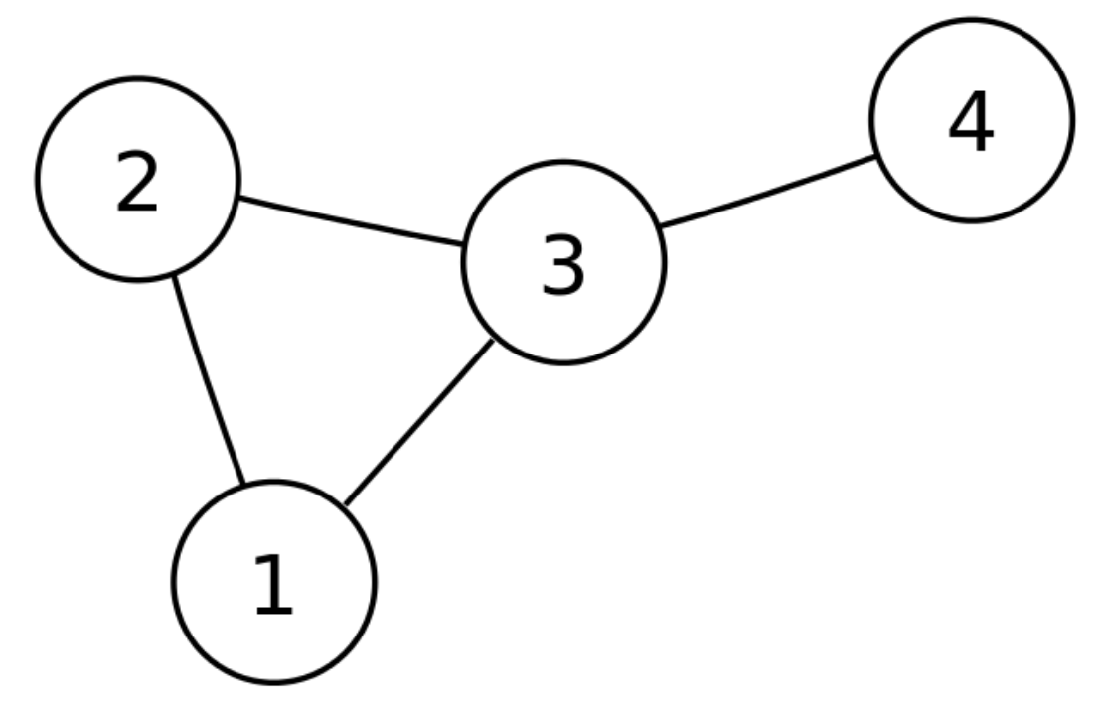
Graph Representation
Directed Graph G = (V, E) V = {1, 2, 3, 4} E = {(1, 2), (1, 3), (3, 2), (3, 4), (4, 3)}
Undirected Graph G = (V, E) V = {1, 2, 3, 4} E = {(1, 2), (2, 1), (1, 3), (3, 1), (3, 2), (2, 3), (3, 4), (4, 3)}

Slide 6
Graph Representation
You are given an undirected graph G = (V, E) V = {1, 2, 3, 4} E = {(1, 2), (2, 1), (1, 3), (3, 1), (3, 2), (2, 3), (3, 4), (4, 3)}
Original representation is not efficient when checking
What are the neighbors of a vertex? O(|E|)
Whether two vertices they are directly connected? O(|E|)

Slide 7
Graph Representation
Original representation is not efficient when
What are the neighbors of a vertex? O(|E|)
Checking whether two vertices they are directly connected? O(|E|)
For ALL graph questions, we always need to get the non-original graph representation first. (No kidding!)
We call it “build a graph” when getting the non-original graph representation.

Slide 8
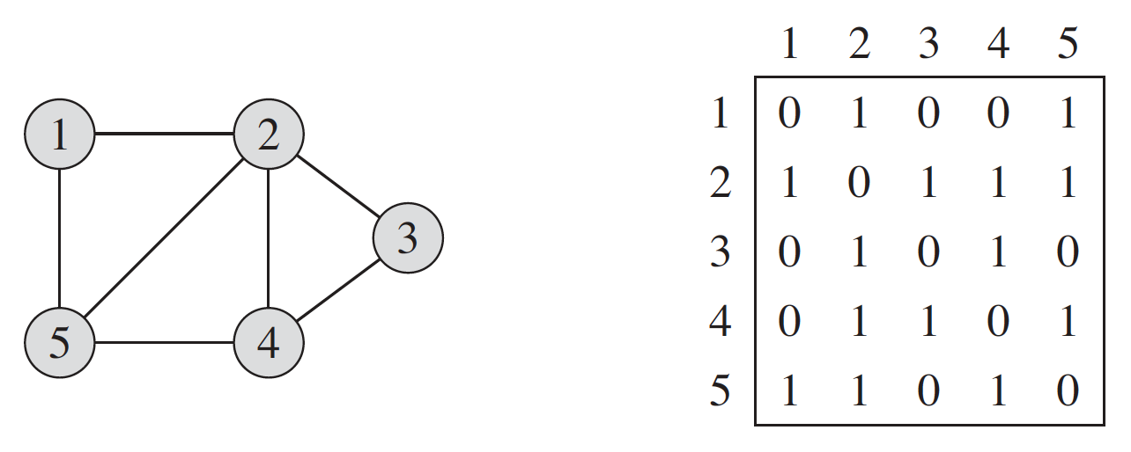
Adjacency Matrix
class Graph {
int[][] matrix;
int n;
public Graph(int n) {
this.n = n;
this.matrix = new int[n][n];
}
void addEdge(int start, int end) {
matrix[start][end] = 1;
}
}

Slide 9
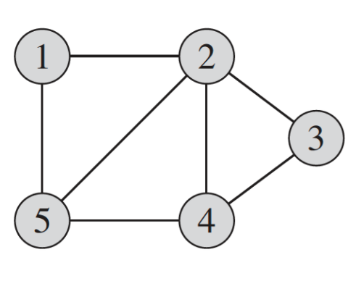
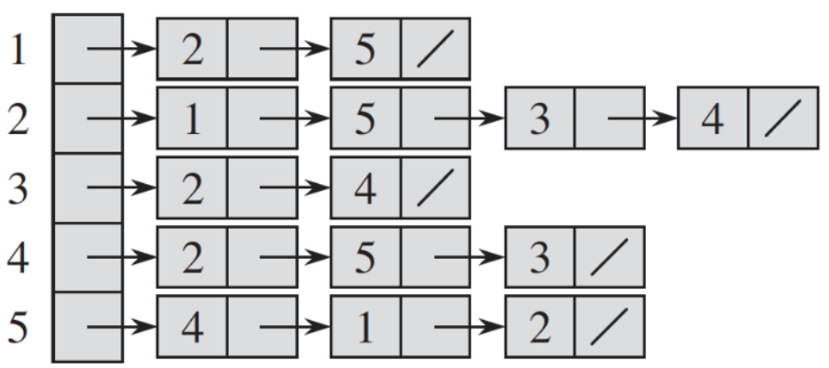
Adjacency List
class Graph {
// array of list. We can also use list of list here.
// adjList[i] contains neighbors of vertex i
List[] adjList;
int n;
public Graph(int n) {
this.n = n;
this.adjList = new List[n];
for (int i = 0; i < n; i++) {
adjList[i] = new LinkedList<>();
}
}
void addEdge(int start, int end) {
adjList[start].add(end);
}
}

Slide 10
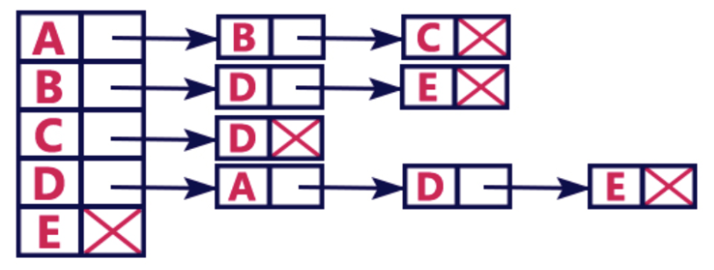
Adjacency List
class Graph {
// vertex, neighbors
Map<String, List<String>> adjMapList;
String[] vertices;
public Graph(String[] vertices) {
this.vertices = vertices;
this.adjMapList = new HashMap<>();
for (String vertex : vertices) {
adjMapList.put(vertex, new LinkedList<>());
}
}
void addEdge(String start, String end) {
adjMapList.get(start).add(end);
}
}

Slide 11
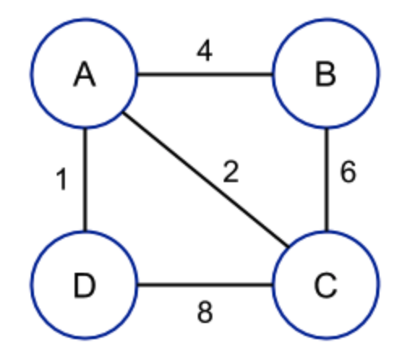
Adjacency Map
class Graph {
// vertex, vertex, weight
Map<String, Map<String, Double>> adjMap;
String[] vertices;
public Graph(String[] vertices) {
this.vertices = vertices;
this.adjMap = new HashMap<>();
for (String vertex : vertices) {
adjMap.put(vertex, new HashMap<>());
}
}
void addEdge(String start, String end, double weight) {
adjMap.get(start).put(end, weight);
}
}

Slide 12
How to Solve Graph Interview Questions
Determine whether the problem can be modeled as a graph problem or not.
Graph and its representation (prerequisite)
What are the most common graph problems?
How to solve graph problems
Breadth-First Search (BFS)
Depth-First Search (DFS)
Topological Sort

Slide 13
Can These Problems be Modeled as Graph Problem?
Evaluate Division
Course Schedule
Keys and Rooms
Word Ladder
Alien Dictionary
Minimum Knight Moves
Accounts Merge
Possible Bipartition

Slide 14
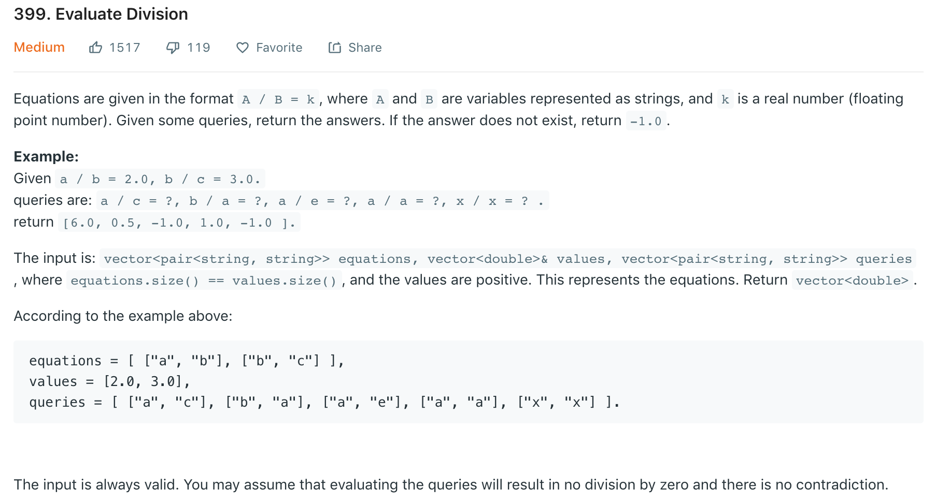
www.leetcode.com

Slide 15
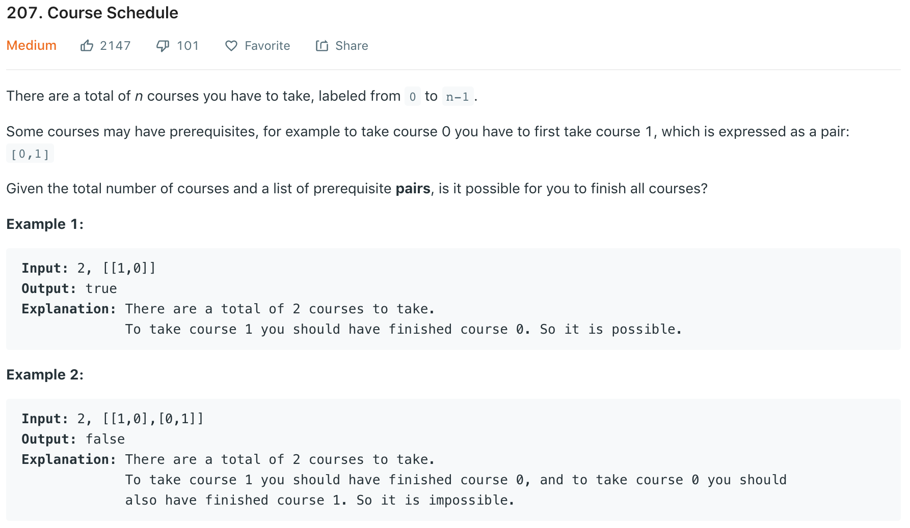
www.leetcode.com

Slide 16
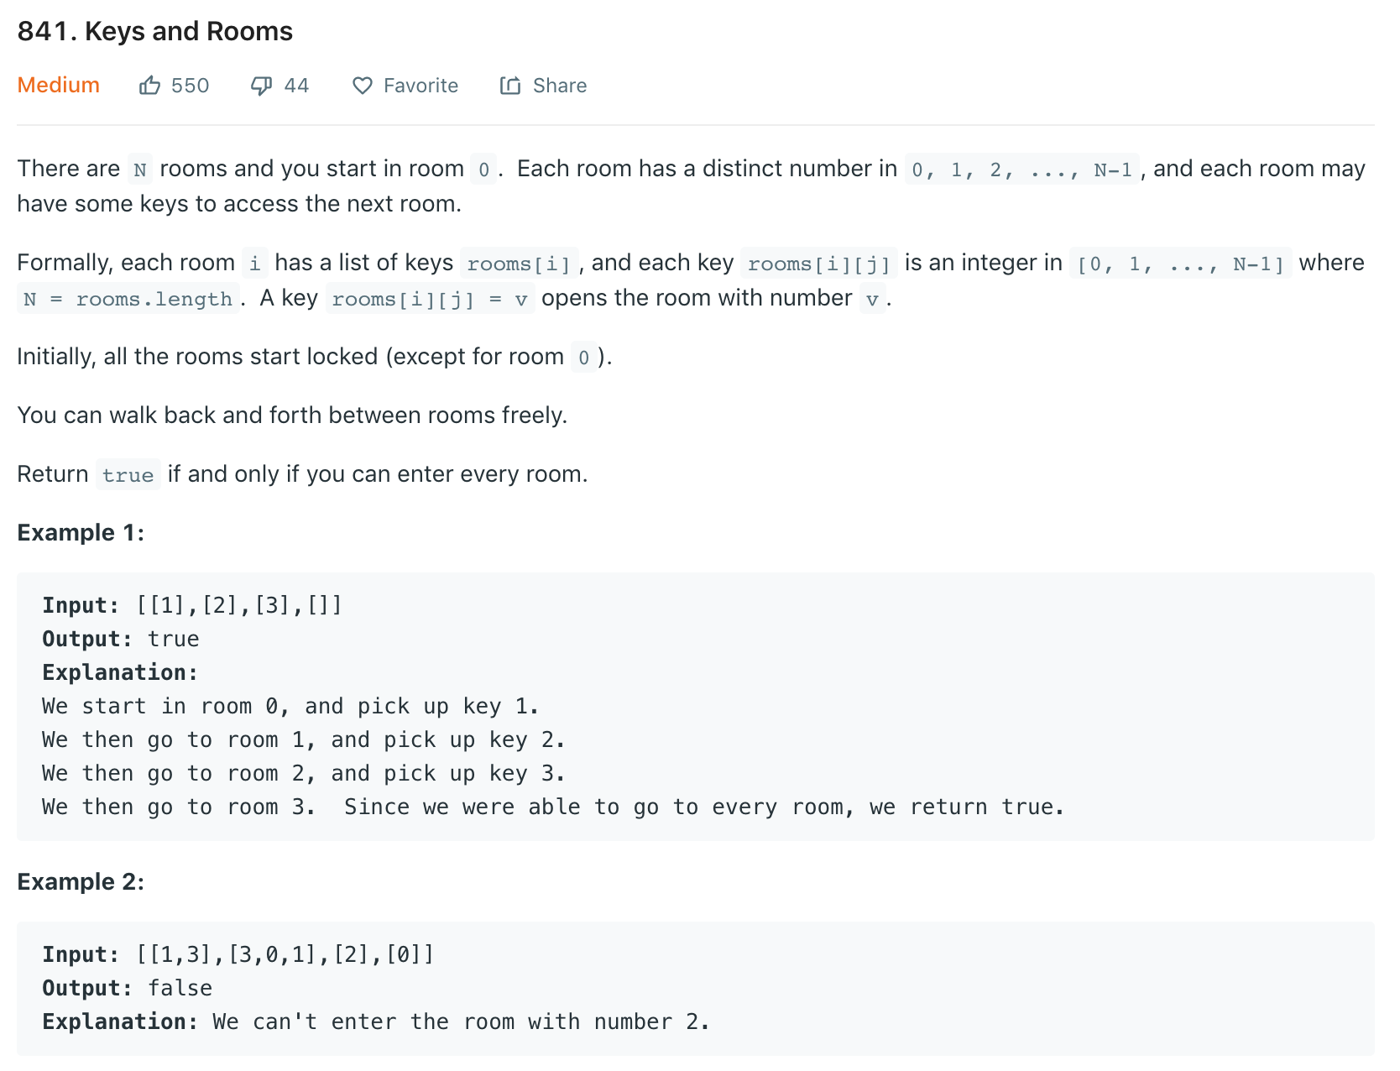
www.leetcode.com

Slide 17
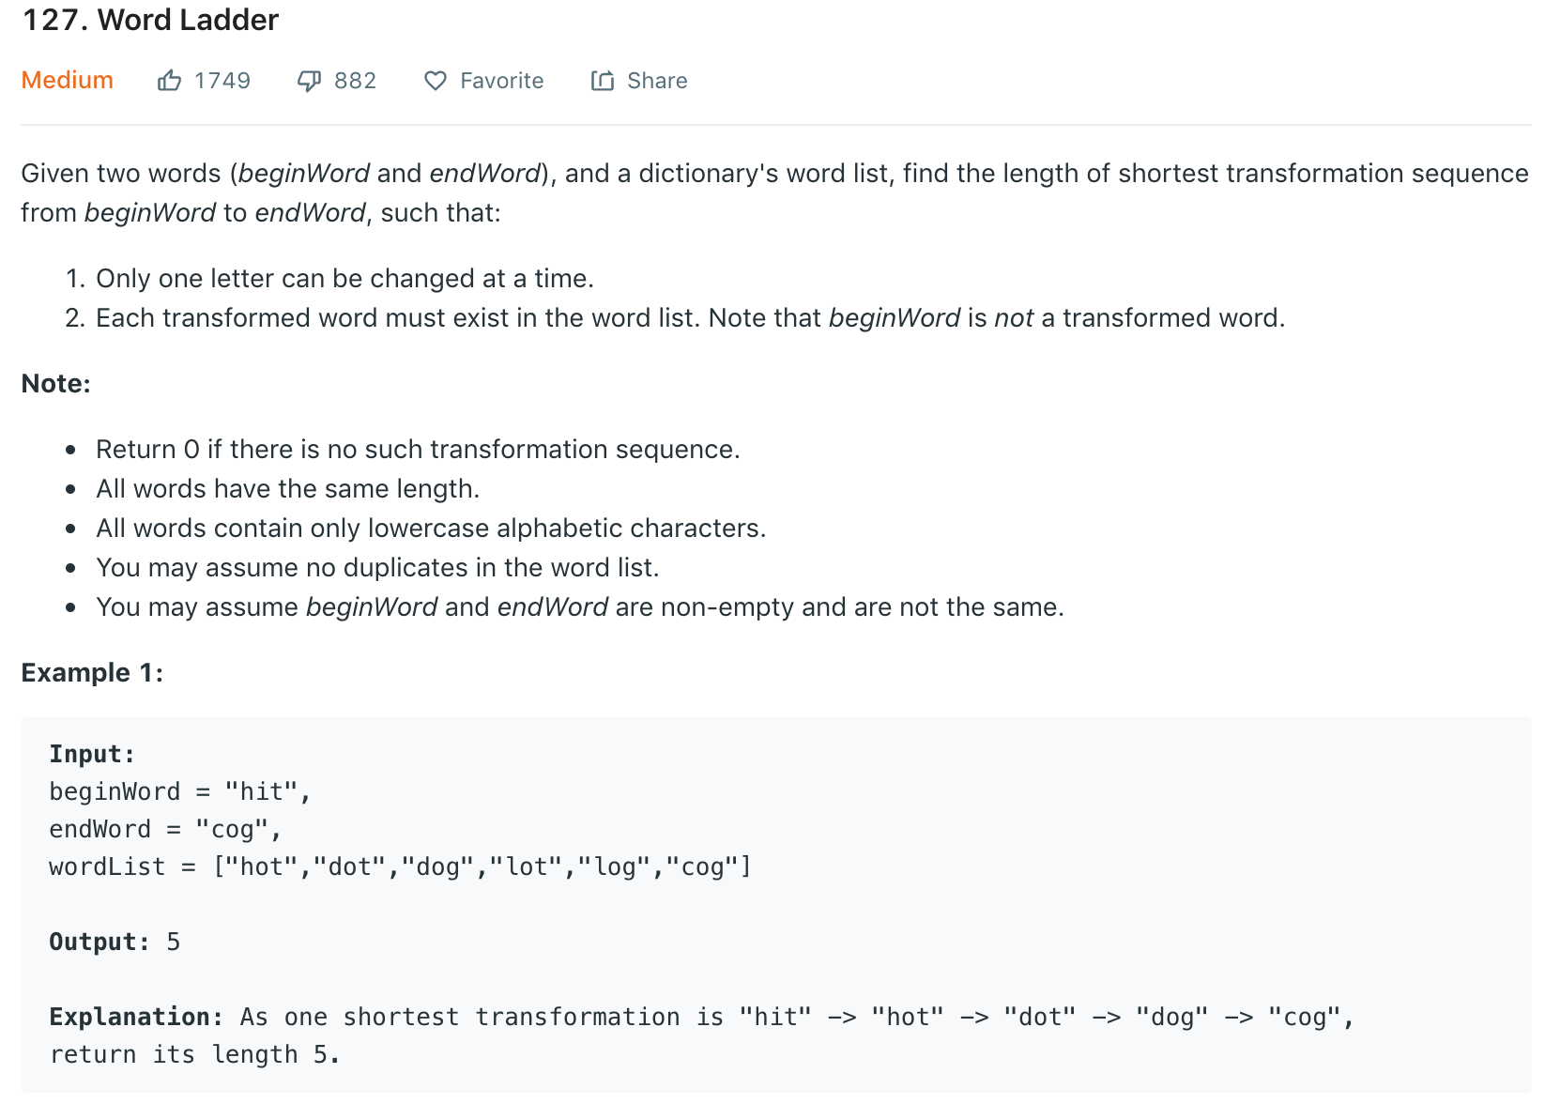
www.leetcode.com

Slide 18
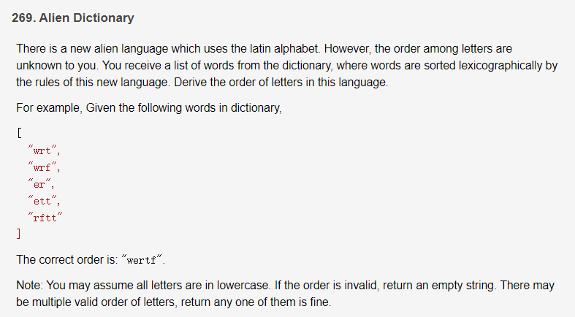
www.leetcode.com

Slide 19
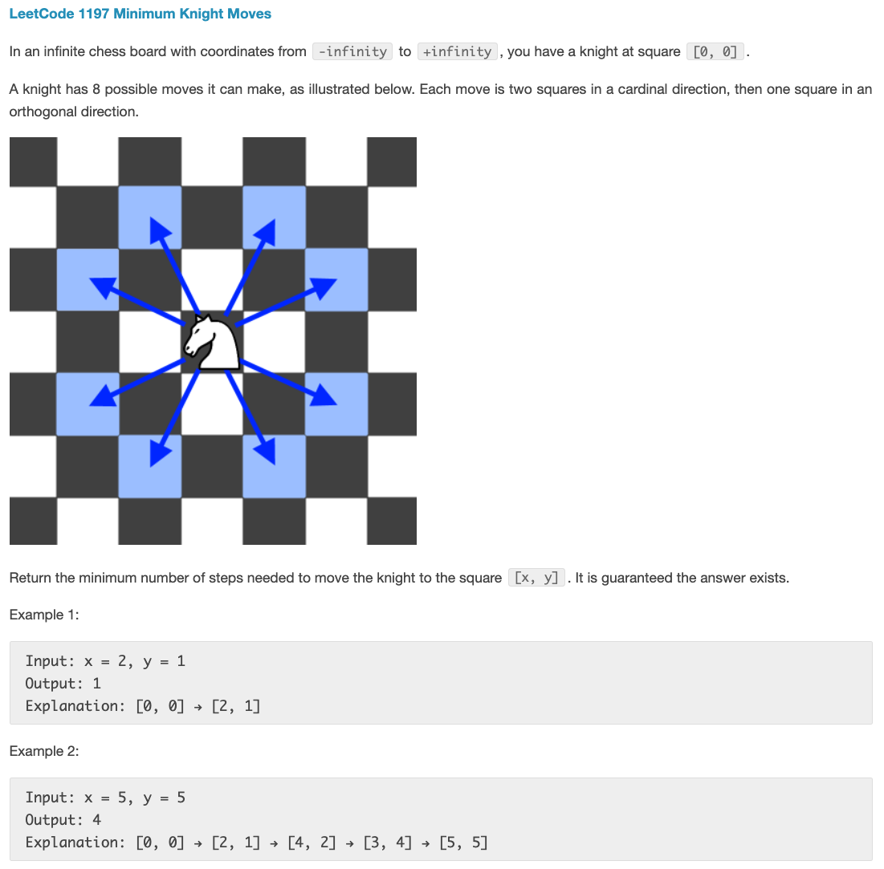
www.leetcode.com

Slide 20
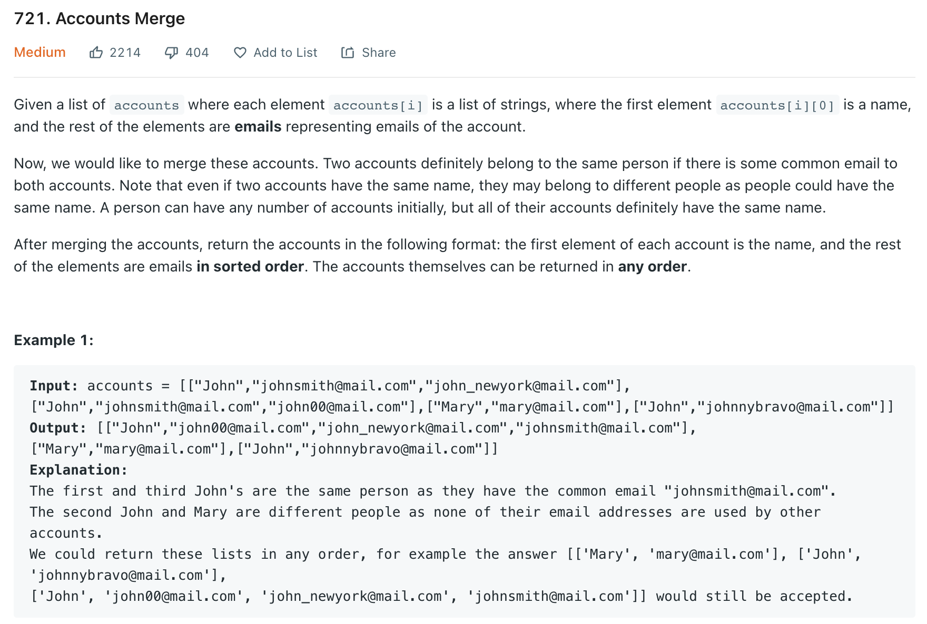
www.leetcode.com

Slide 21
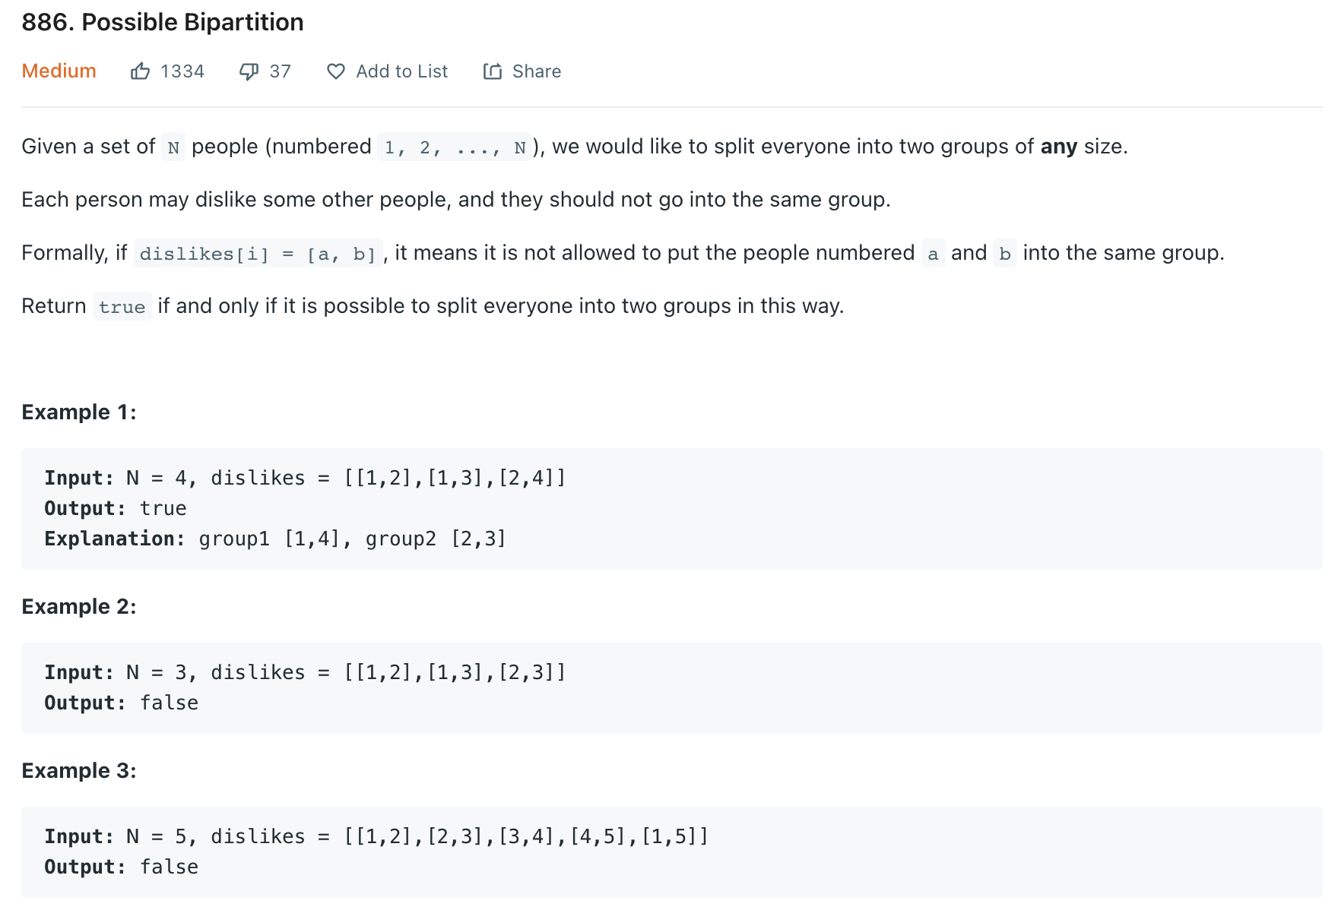
www.leetcode.com

Slide 22
Is It a Graph Problem?
Determine whether the data in the problem can be modeled as vertices or not?
Determine whether the vertices are connected or not?
If both answers are yes, then we can model that problem as graph problem
Identifying the category of the question is the FIRST thing you should do after you FULLY understand the question in the interview!

Slide 23
How to Solve Graph Interview Questions
Determine whether the problem can be modeled as a graph problem or not.
Graph and its representation (prerequisite)
What are the most common graph problems?
How to solve graph problems
Breadth-First Search (BFS)
Depth-First Search (DFS)
Topological Sort

Slide 24
Most Common Graph Problems
Traverse all the vertices in a graph (Keys and Rooms, Jump Game III)
Whether two vertices are connected or not (Division Evaluation)
Shortest path between two vertices (Shortest Path in Binary Matrix, Word Ladder I & II, Walls and Gates, As Far from Land as Possible, K-similar Strings)
Number of connected components (Friend Circles, Accounts Merge, Number of Islands)
Vertex Grouping (Is Graph Bipartite? Possible Bipartition)
Dependency path (Course Schedule II, Alien Dictionary)
Detect cycle in a graph (Course Schedule I, Valid Tree Graph)
All possible paths (Word Search, Binary Tree Paths, All Paths From Source to Target)

Slide 25
How to Solve Graph Interview Questions
Determine whether the problem can be modeled as a graph problem or not.
Graph and its representation (prerequisite)
What are the most common graph problems?
How to solve graph problems
Breadth-First Search (BFS)
Depth-First Search (DFS)
Topological Sort

Slide 26
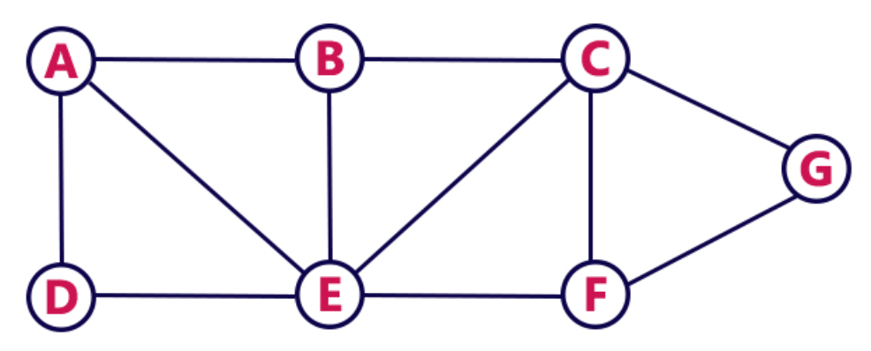
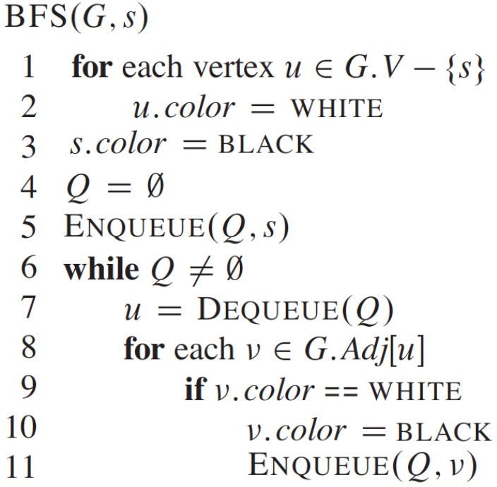
BFS
Time Complexity: O(|V| + |E|)
Space Complexity: O(|V|)
http://btechsmartclass.com

Slide 27
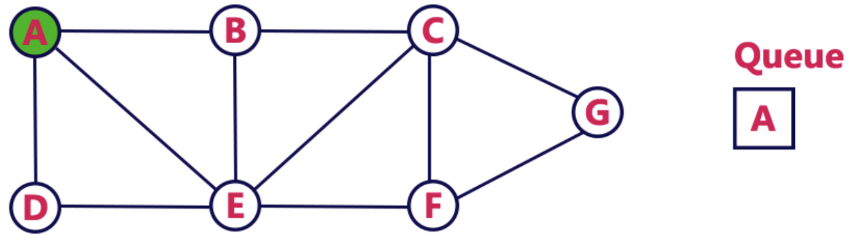
BFS
Step 1: Enqueue A, and mark it as VISITED
http://btechsmartclass.com

Slide 28
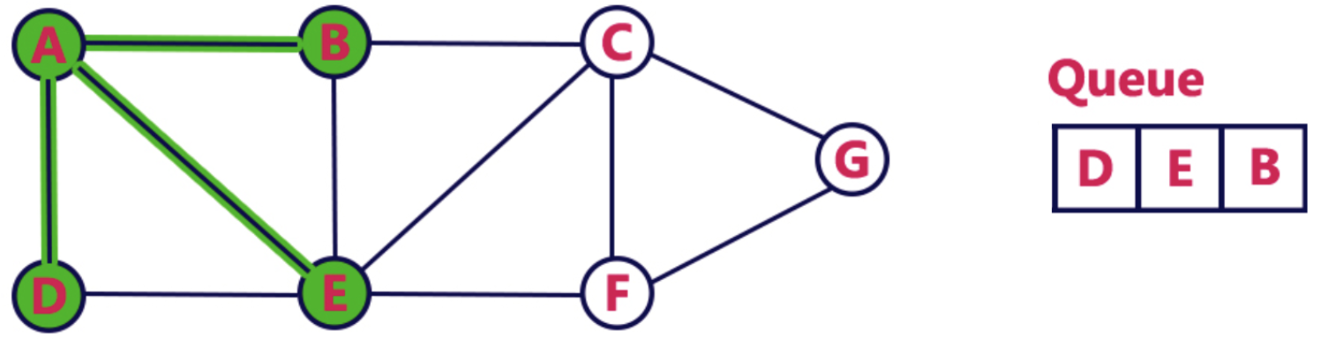
BFS
Step 2: Dequeue A, and enqueue its unvisited neighbors (B, D, E) and mark them as VISITED.
http://btechsmartclass.com

Slide 29
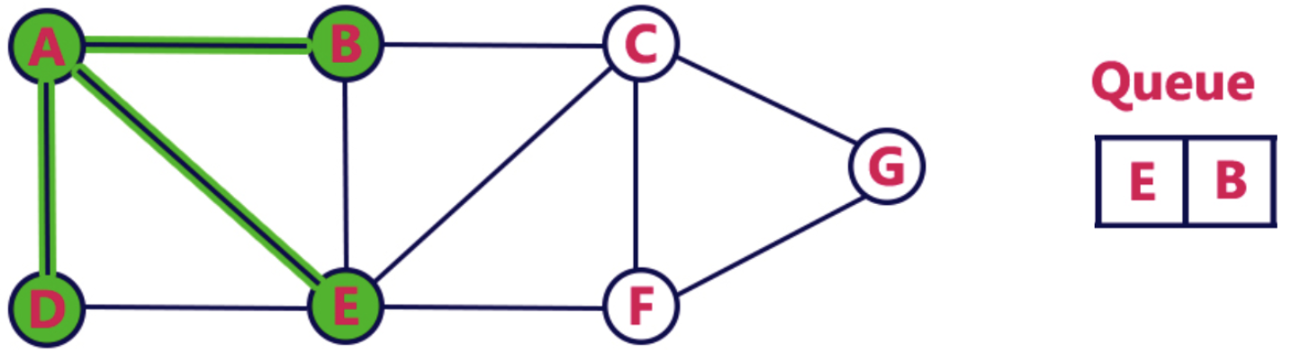
BFS
Step 3: Dequeue D
http://btechsmartclass.com

Slide 30
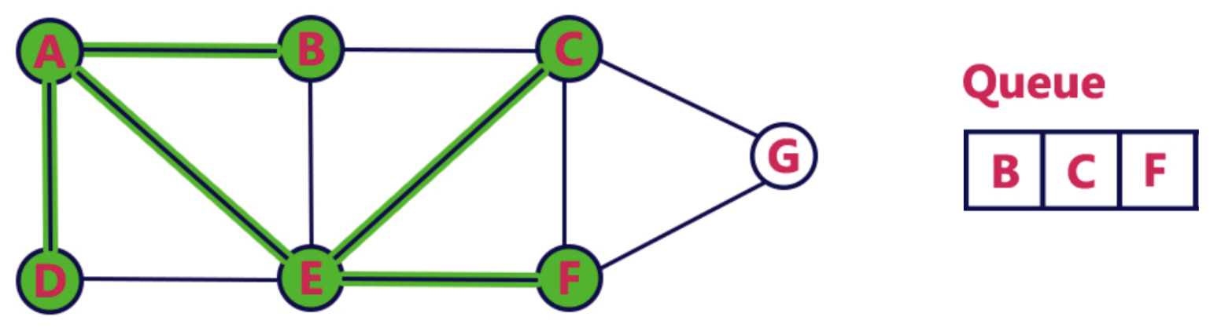
BFS
Step 4: Dequeue E, and enqueue its unvisited neighbors (C, F) and mark them as VISITED
http://btechsmartclass.com

Slide 31
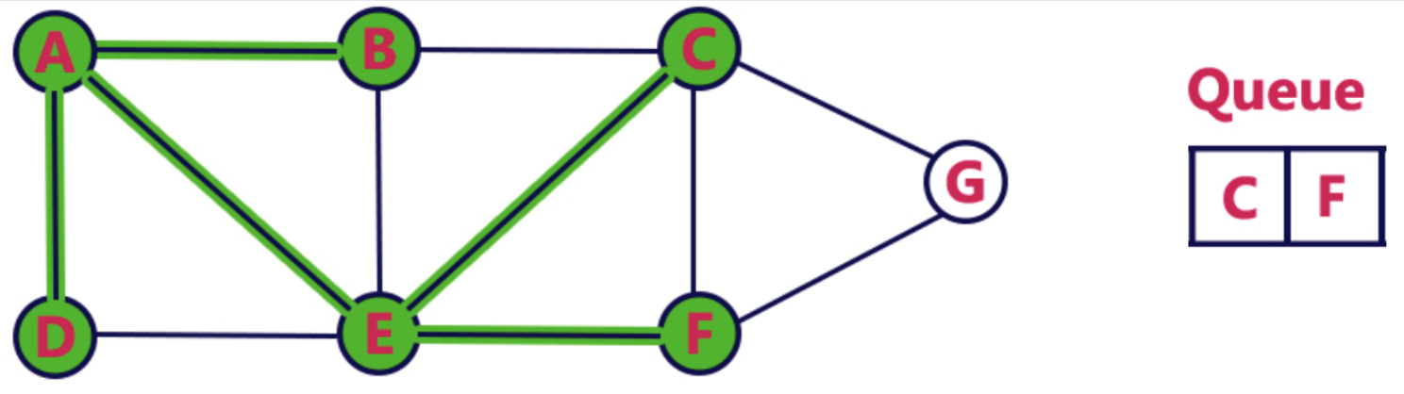
BFS
Step 5: Dequeue B
http://btechsmartclass.com

Slide 32
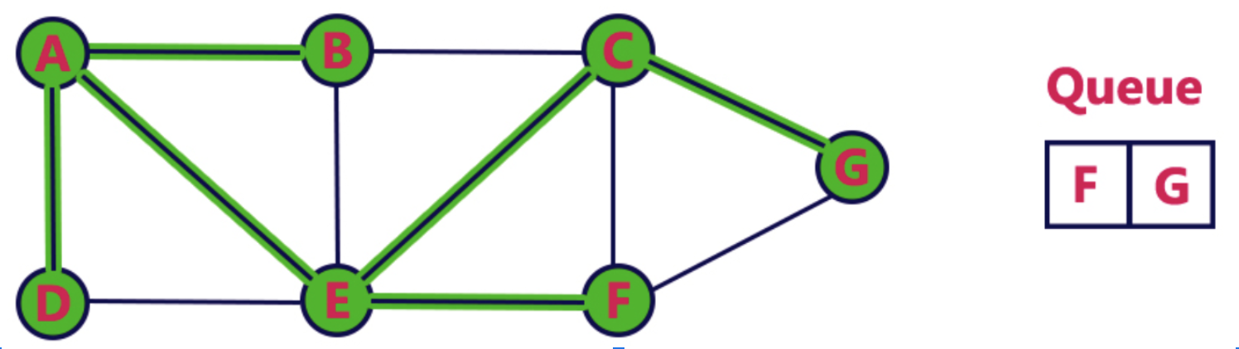
BFS
Step 6: Dequeue C, and enqueue its unvisited neighbors (G) and mark it as VISITED
http://btechsmartclass.com

Slide 33
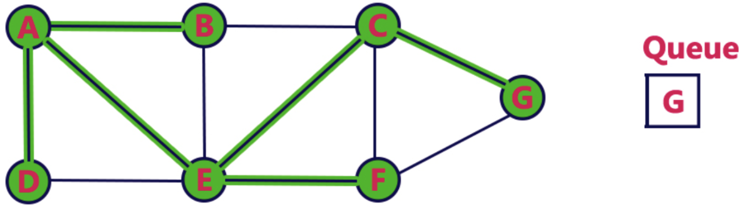
BFS
Step 7: Deque F
http://btechsmartclass.com

Slide 34
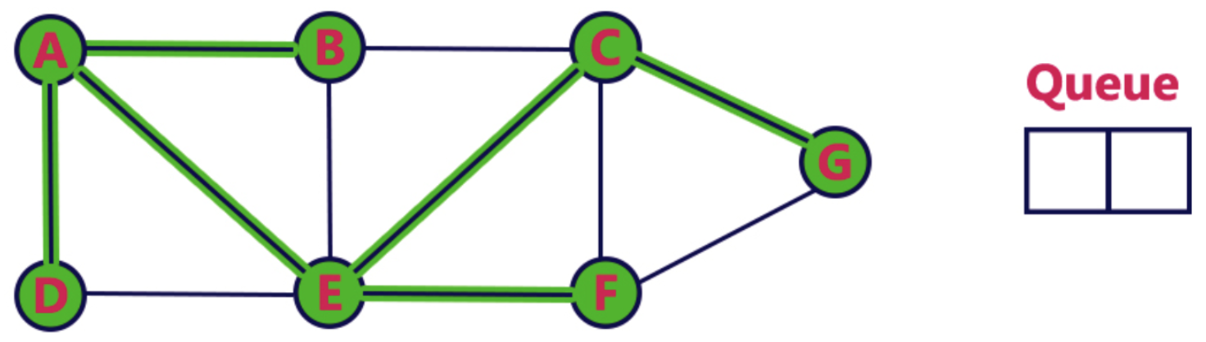
BFS
Step 8: Queue becomes empty, exit
http://btechsmartclass.com

Slide 35

Do You Know How Gossip Works? :-)
https://confessionsofanadoptiveparent.com

Slide 36
BFS Complexity
Time Complexity: O(|V| + |E|)
Space Complexity: O(|V|)
http://btechsmartclass.com

Slide 37
Amortized Analysis
The motivation for amortized analysis is that looking at the worst-case run time per operation.
For BFS, operation at line 2 and line 9 decide the time complexity of the whole algorithm.
How many vertices will be checked? It is decided by |E|.
https://en.wikipedia.org/wiki/Amortized_analysis

Slide 38
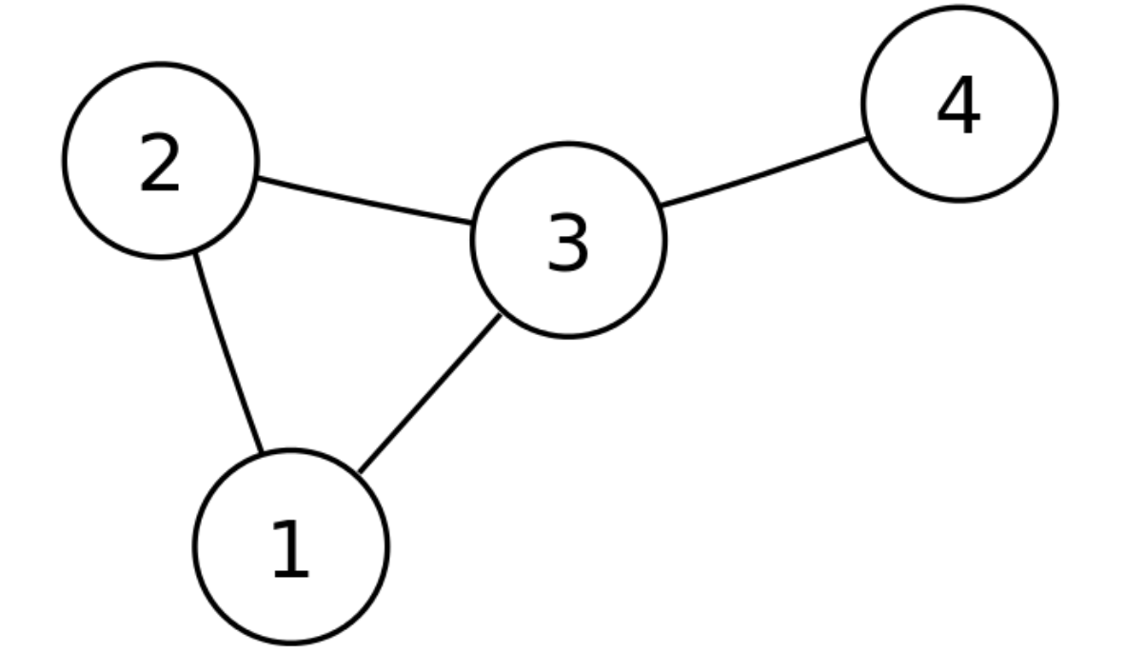
BFS Implementation (Java)
Input: N and a list of edges
Example:
N= 4
Edges = {(1, 2), (2, 1), (1, 3), (3, 1), (3, 2), (2, 3), (3, 4), (4, 3)}

Slide 39
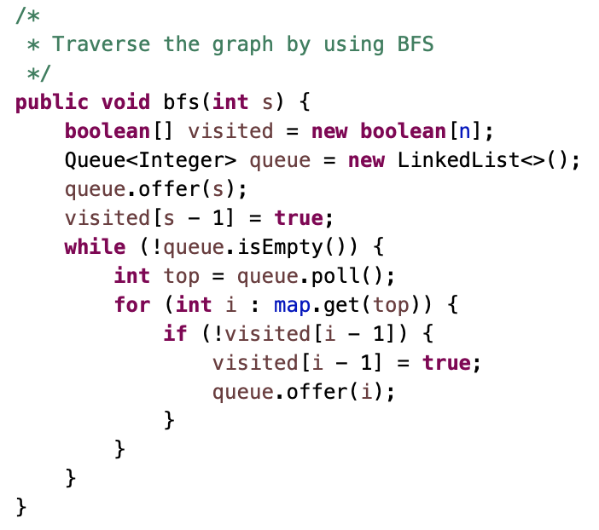
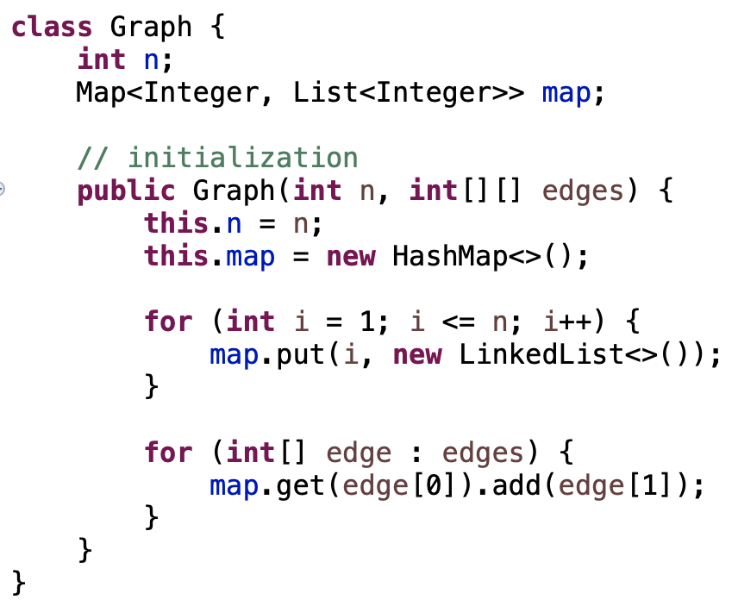
BFS Implementation

Slide 40
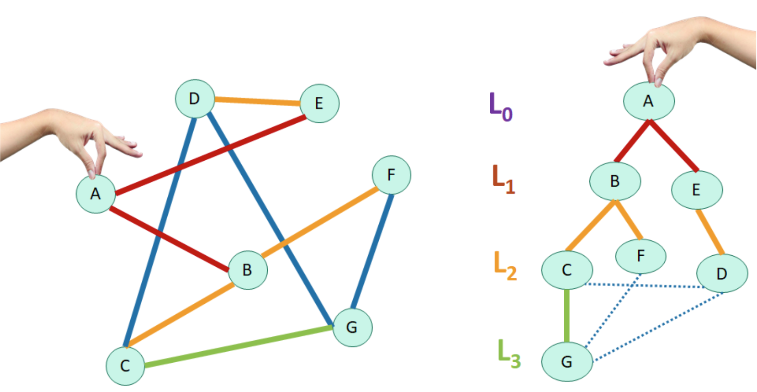
BFS
BFS traverses by level.
The number of levels is also the shortest distance between two vertices.
Question: how to calculate the level for each vertex?
Visualized
BFS Traversal
Original Graph

Slide 41
How to Get the Number of Levels in BFS?
There is only one queue to store neighbors in BFS approach, how do we know which nodes vertices are in the same level?
Important Fact: Queue only has vertices in a single level when the vertices in the previous level have been popped out.
We could use count of vertices in each level as “virtual” divider to separate vertices.

Slide 42
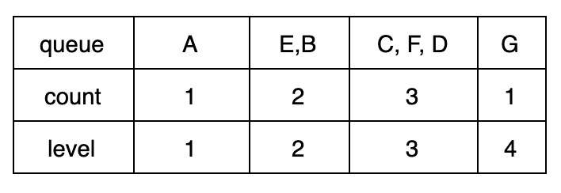
Levels in BFS

Slide 43
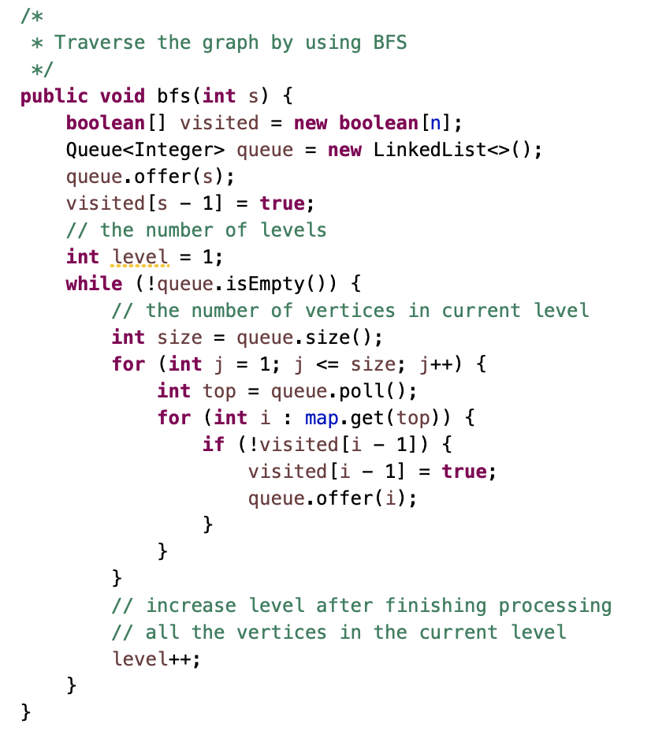
BFS by Level

Slide 44
What Problems Can be Solved by BFS?
Traverse all vertices in a graph
Whether two vertices are connected or not
Shortest path between two vertices (preferred approach)
Number of connected components
Vertex grouping
Dependency path
Detect cycle in a graph
All possible paths

Slide 45
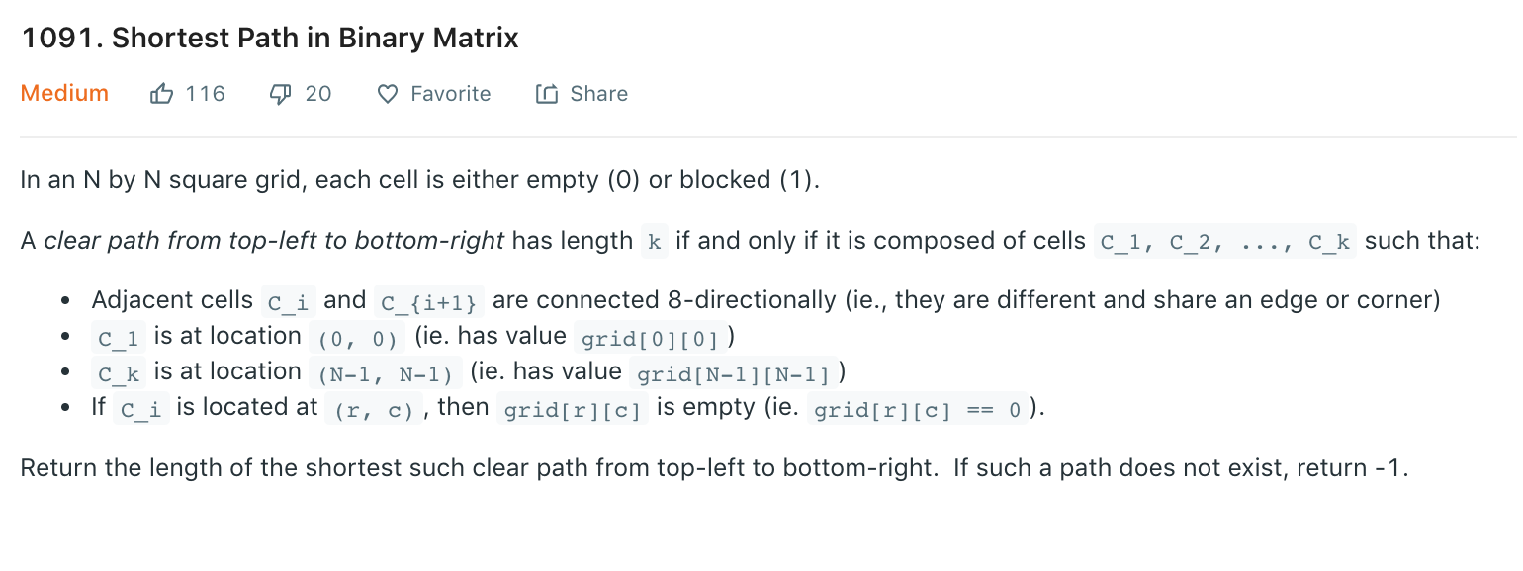
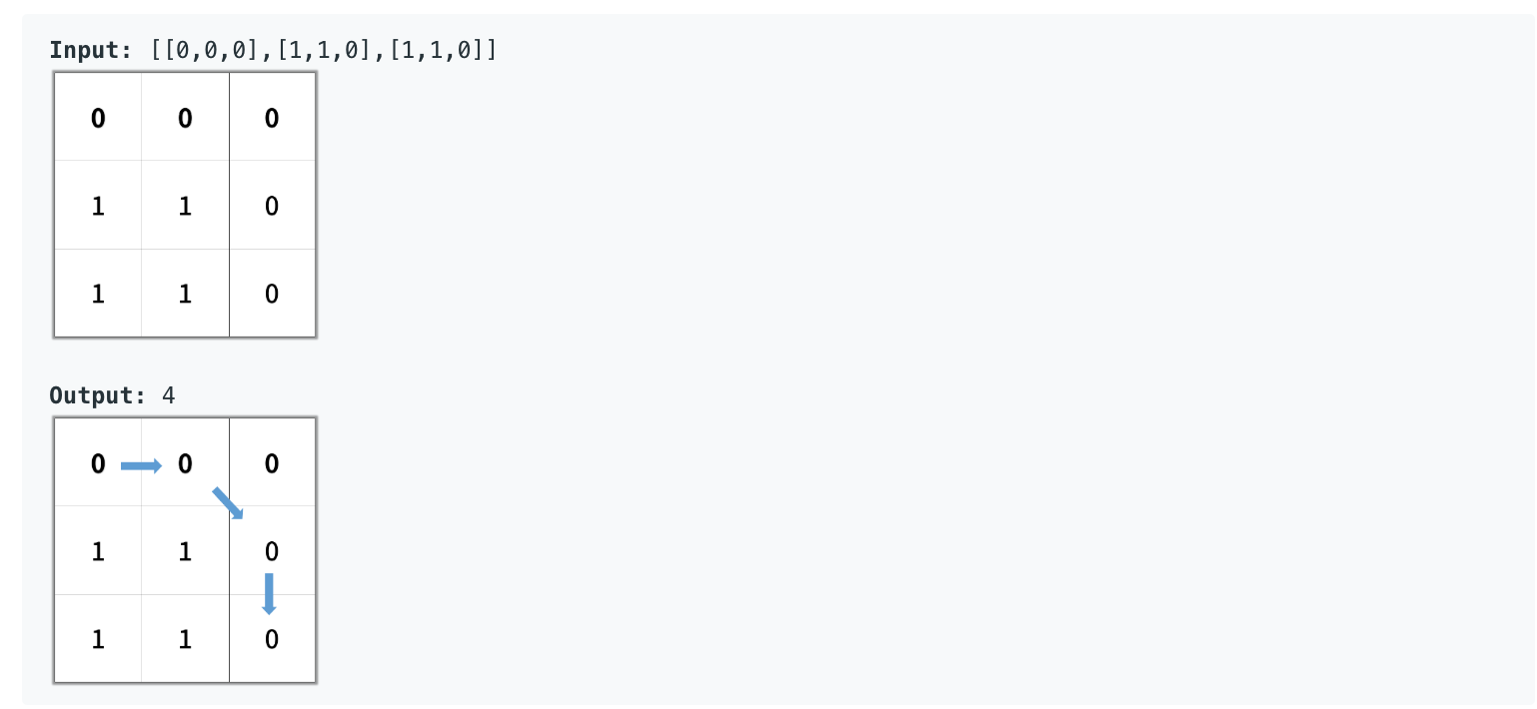
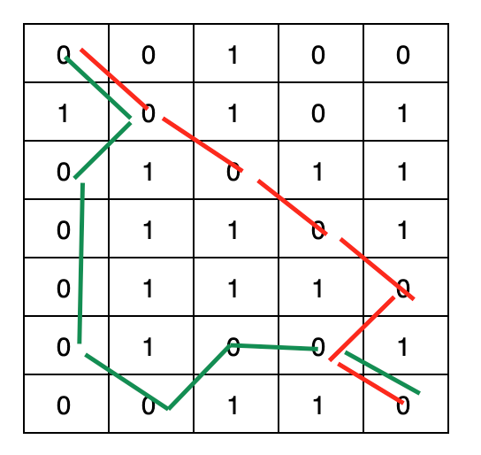
Question

Slide 46
Shortest Path in Binary Matrix
Idea:
This is essentially a graph problem (tell them why, and how the graph is represented)
I can use BFS approach to solve this problem.
When traversing, we use two variables: one keeps track of the number of levels, and the other one tracks the number of vertices in each level.
During BFS traversal, if we visit the target vertex, return the number of levels. However, if the target vertex is not visited during BFS traversal, return -1.

Slide 47
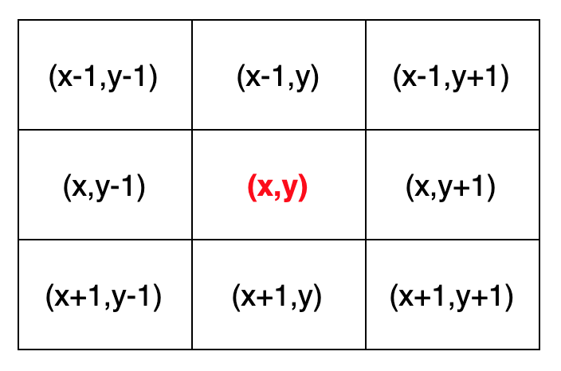
Directions
Right Left Down Up B-L T-R T-L B-R
int dir[][] = { { 0, 1 }, { 0, -1 }, { 1, 0 }, { -1, 0 }, { 1, -1 }, { -1, 1 }, { -1, -1 }, { 1, 1 } };
column
row

Slide 48
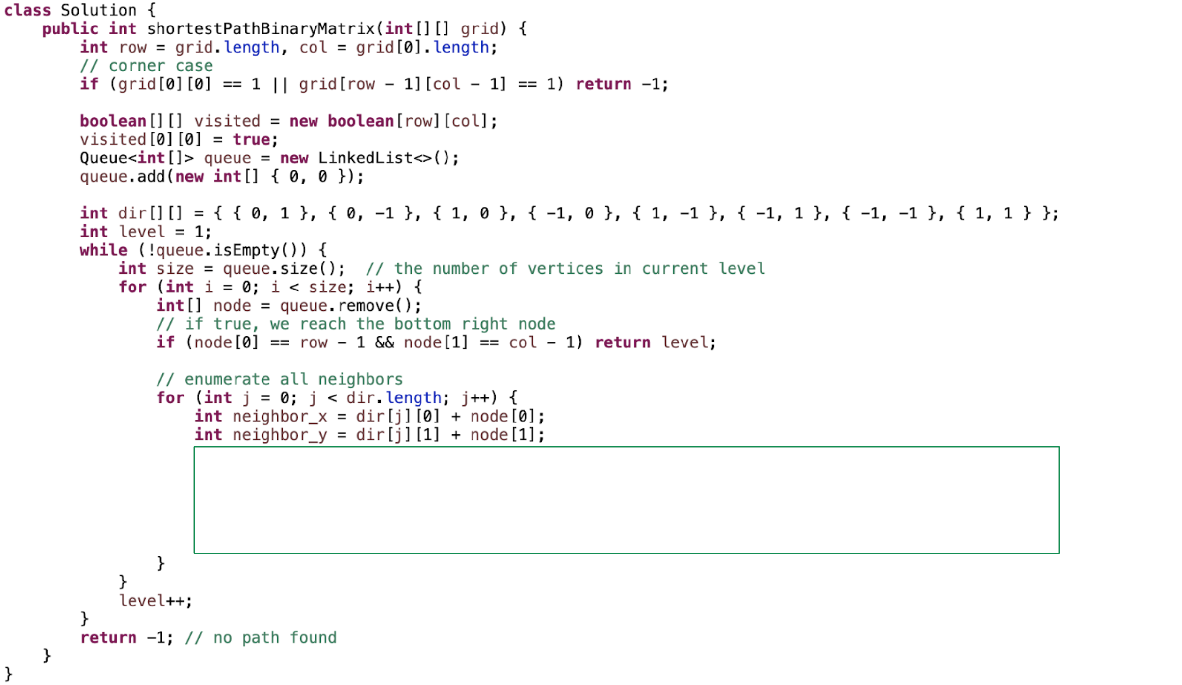
Solution

Slide 49
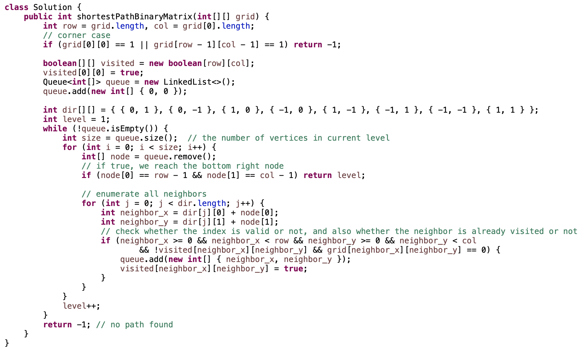
Solution

Slide 50
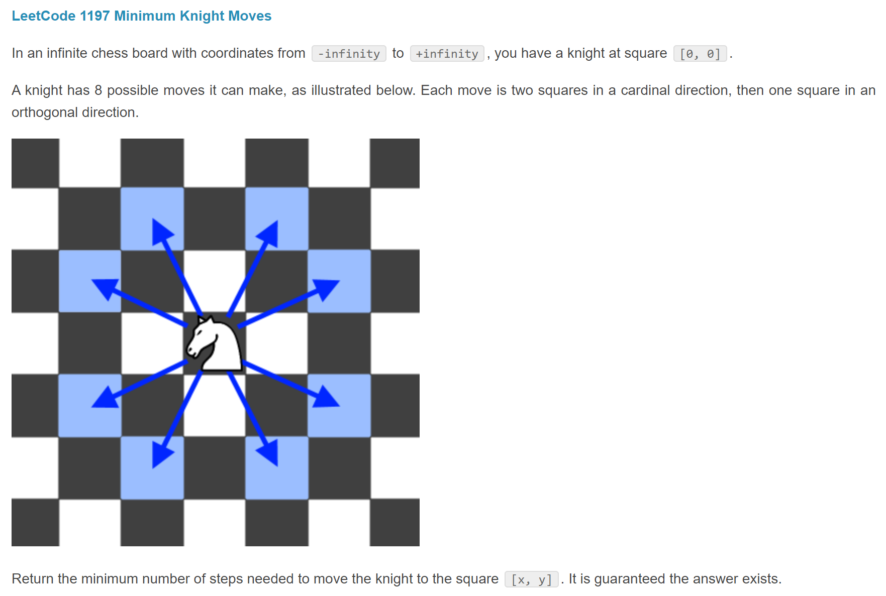
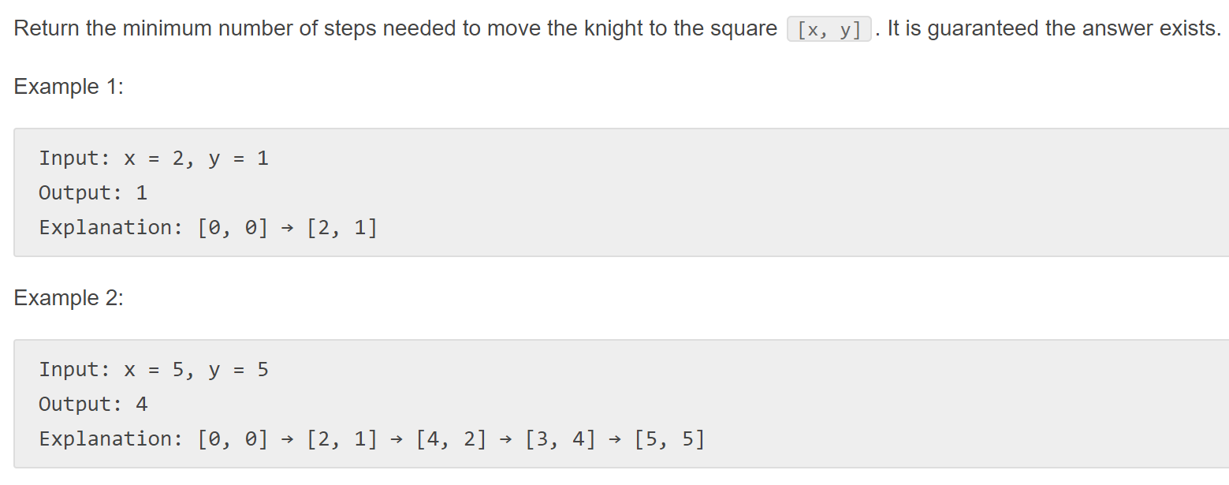
Similar Question (Practice Offline)

Slide 51
How to Solve Graph Interview Questions
Determine whether the problem can be modeled as a graph problem or not.
Graph and its representation (prerequisite)
What are the most common graph problems?
How to solve graph problems
Breadth-First Search (BFS)
Depth-First Search (DFS)
Topological Sort

Slide 52
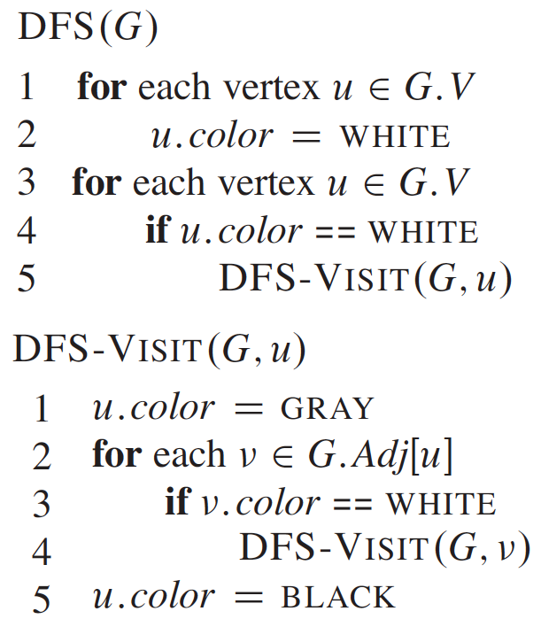
DFS
Time Complexity: O(|V| + |E|)
Space Complexity: O(|V|)
http://btechsmartclass.com

Slide 53
Colors in DFS
White: the vertex is unvisited
Gray: the current vertex has been visited, but we are still visiting all its neighbors. (being visited)
Black: the current vertex has been visited, and all of its neighbors have been visited as well.

Slide 54
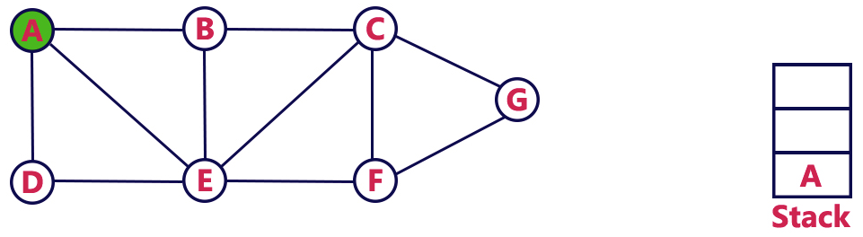
DFS
Step 1: Push A to stack, and mark it as VISITED
http://btechsmartclass.com

Slide 55
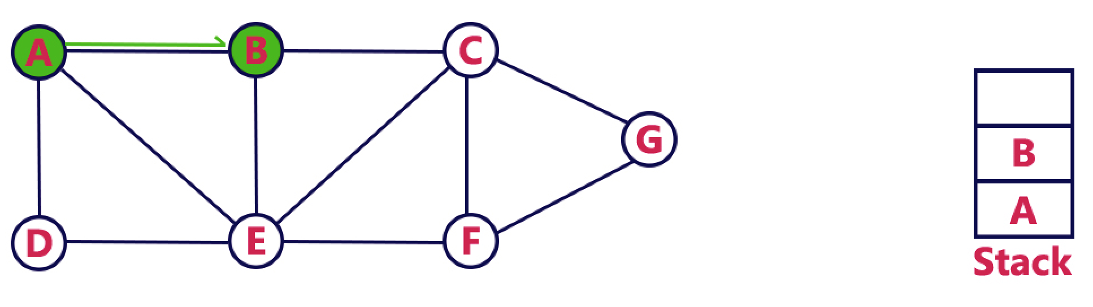
DFS
Step 2: Find A’s first neighbour B, and push B to stack, and mark B as VISITED
http://btechsmartclass.com

Slide 56
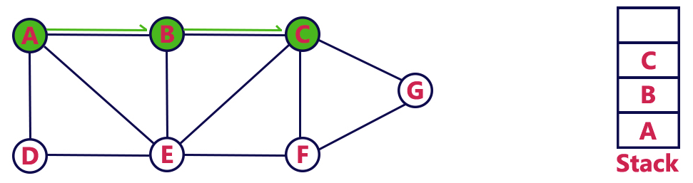
DFS
Step 3: Find B’s first neighbour C, and push C to stack, and mark C as VISITED
http://btechsmartclass.com

Slide 57
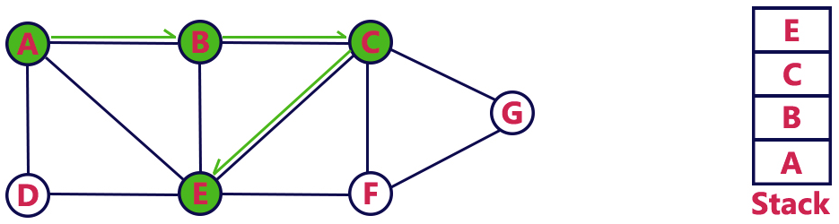
DFS
Step 4: Find C’s first neighbour E, and push E to stack, and mark E as VISITED
http://btechsmartclass.com

Slide 58
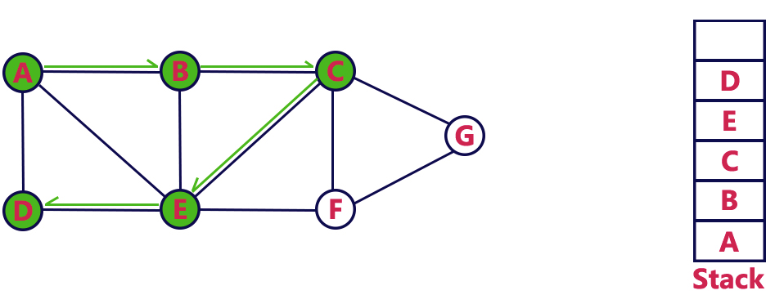
DFS
Step 5: Find E’s first unvisited neighbour D, and push D to stack, and mark D as VISITED
http://btechsmartclass.com

Slide 59
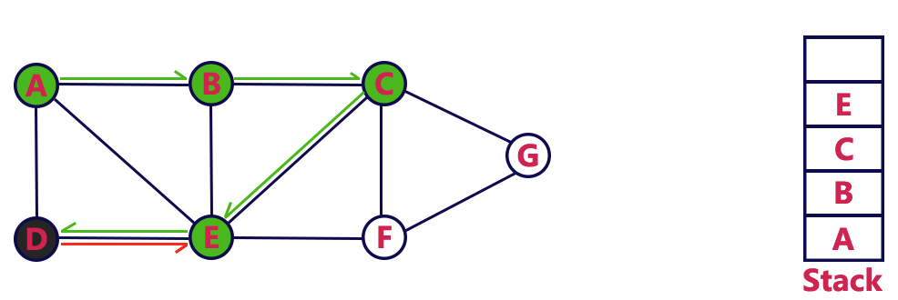
DFS
Step 6: As D doesn’t have unvisited neighbour, return (pop stack)
http://btechsmartclass.com

Slide 60
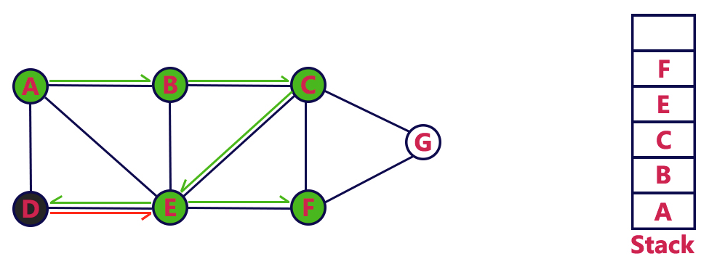
DFS
Step 7: Find E’s second unvisited neighbour (F), push F to stack and mark F as VISITED
http://btechsmartclass.com

Slide 61
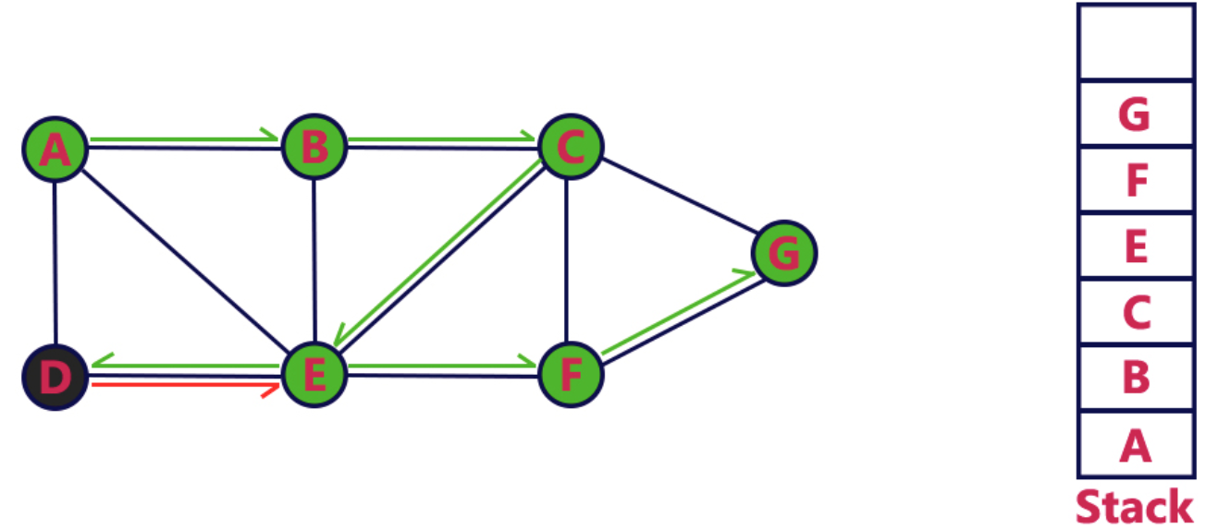
DFS
Step 8: Find F’s first unvisited neighbour (G), push G to stack and mark G as VISITED
http://btechsmartclass.com

Slide 62
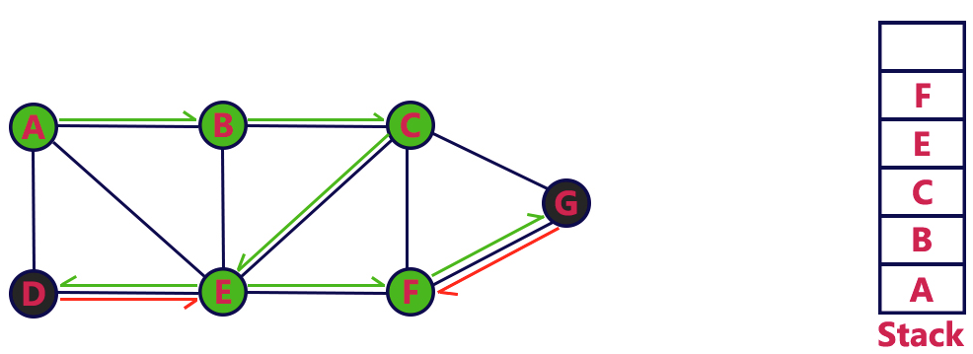
DFS
Step 9: As G doesn’t have unvisited neighbour, we are done with G (pop stack)
http://btechsmartclass.com

Slide 63
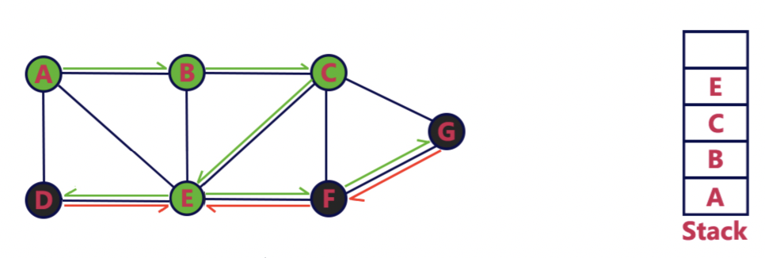
DFS
Step 10: As F doesn’t have unvisited neighbour, we are done with F (pop stack)
http://btechsmartclass.com

Slide 64

DFS
Step 11: As E doesn’t have unvisited neighbour, we are done with E (pop stack)
http://btechsmartclass.com

Slide 65

DFS
Step 12: As C doesn’t have unvisited neighbours, we are done with C (pop stack)
http://btechsmartclass.com

Slide 66

DFS
Step 13: As B doesn’t have unvisited neighbour, we are done with B (pop stack)
http://btechsmartclass.com

Slide 67

DFS
Step 14: As A doesn’t have unvisited neighbour, we are done with A (pop stack)
http://btechsmartclass.com

Slide 68

DFS Implementation

Slide 69

DFS Implementation (Simplified)

Slide 70
What Problems Can be Solved by DFS?
Traverse all vertices in a graph
Whether two vertices are connected or not
Shortest path between two vertices
Number of connected components
Vertex grouping
Dependency path
Detect cycle in a graph (preferred approach)
All possible paths (preferred approach)

Slide 71

Question
www.leetcode.com

Slide 72
Keys and Rooms
Idea:
This is essentially a graph problem (tell why, and how graph is represented.)
I can use DFS approach to solve this problem (we can also use BFS)
Keep track of number of visited vertices.
If the number of visited vertices is NOT equal to the number of vertices in the graph, return false, otherwise, return true.

Slide 73

Solution

Slide 75
Evaluate Division
Idea:
This is essentially a graph problem (tell them why, and how the graph is represented.)
I will use DFS approach to solve this problem.
Basically, we need to check whether source vertex and target vertex are connected or not. If they are, we get the weight multiplication from source to target vertex.
We first begin with source vertex and check whether the source vertex and target vertex are one the same edge or not.
If yes, return the weight. Otherwise, we check whether the neighbors of the source vertex connected with the target vertex or not (recursion may apply). If yes, return the weight, otherwise, return -1.

Slide 76

Solution

Slide 77

Solution

Slide 78


How to Detect Cycle in Directed Graph?
Have cycle
B -> C -> E -> D -> B
No Cycle

Slide 79

Back Edge
A back edge is an edge that is from a vertex to itself or one of its ancestors in the graph when traversing by using DFS.
There is a cycle in a graph only if there exists a back edge in the graph.

Slide 80

How to Find Back Edge?
In DFS traversal, if we visit a vertex whose color is gray, we can say there is a back edge!

Slide 81


Implementation

Slide 82


How to Detect Cycle in Undirected Graph?
Have Cycle
1 -> 2 -> 3 -> 4 -> 1
No Cycle

Slide 83
How to Detect Cycle in Undirected Graph?
In undirected graph, if we traverse from vertex A to vertex B directly, vertex A is considered as parent of vertex B.
The edge to the parent of a vertex should NOT be counted as a back edge, there, we need to pass in parent in DFS traversal.
If we can find any already visited vertex (not parent) in DFS traversal, it indicates there exists a back edge.

Slide 84


How to Detect Cycle in Undirected Graph?

Slide 85


Slide 86
Course Schedule I
Idea:
This is essentially a graph problem (tell them why, and how the graph is represented.)
Basically, we need to check whether there is a cycle in the graph or not.
I will use DFS to check whether there is a back edge in the graph or not.
If there is no back edge, the courses can be scheduled, otherwise, they cannot be scheduled.

Slide 87

Solution

Slide 88
Topological Sort
Real life question: you are given a list of tasks with dependency, determine the execution order of the tasks.
Topological sort of a directed graph is a linear ordering of its vertices such that for every directed edge (u,v) from vertex u to vertex v, u comes before v in the ordering.
A topological ordering is possible if and only if the graph has no cycles.

Slide 89
Topological Sort Algorithm
L ← Empty list Q ← Set of all nodes with no incoming edge while Q is non-empty do remove a node n from Q add n to tail of L for each node m with an edge e from n to m do remove edge e from the graph if m has no other incoming edges then insert m into Q if graph has unvisited nodes then return error (graph has at least one cycle) else return L (a topologically sorted order)

Slide 90

Topological Sort Algorithm
https://en.wikipedia.org/wiki/Topological_sorting

Slide 91

Topological Sort Algorithm
Indegree: For a vertex, the value of indegree is equal to the number of incoming edges.
Indegree of vertex 3, 5, 7: 0
Indegree of vertex 2: 1
Indegree of vertex 8, 9 10, 11: 2
https://en.wikipedia.org/wiki/Topological_sorting

Slide 92
What Problems Can be Solved by Topological Sort?
Traverse all vertices in a graph
Whether two vertices are connected or not
Shortest path between two vertices
Number of disconnected components
Vertex grouping
Dependency path
Detect cycle in a graph
All possible paths

Slide 93


Slide 94
Course Schedule II
Idea:
This is essentially a graph problem (tell them why, and how the graph is represented)
In order to find the orders, I will use Topological Sort because there is a dependency between courses.
We first put courses with 0 indegree (no prerequisites) into a queue
We remove one course from the queue, put it into our result list, and decrease the indegree of its neighbors.
If the indegree of the neighbor is 0, we add it to the queue.
We repeat the last two steps until the queue is empty.
If the result list size is the same with number of courses, we return the result list, otherwise, return an empty list.

Slide 95


Solution

Slide 96
How to Solve Graph Interview Questions
Determine whether the problem can be modeled as a graph problem or not.
Graph and its representation (prerequisite)
What are the most common graph problems?
Traverse all the vertices in a graph
Whether two vertices are connected or not
Shortest path between two vertices
Number of connected components
Vertex grouping
Dependency path
Detect cycle in a graph
All possible paths
How to solve graph problems
Breadth-First Search (BFS)
Depth-First Search (DFS)
Topological Sort

Slide 97
Extra Slides

Slide 98


Exercise
Build an undirected graph based on a binary tree

Slide 99

Answer
863. All Nodes Distance K in Binary Tree

Slide 100

Question

Slide 101
Is Graph Bipartite
Idea:
I can use BFS approach to solve this problem.
Assign black color to one vertex and white color to the other vertex on the same edge, and color represents group.
If both vertices on the same edge have the same color, return false.
If no vertices on the same edge have the same color and the while loop is terminated, return true.

Slide 102

Solution

Slide 104
Course Schedule I
Idea:
This is essentially a graph problem (tell them why, and how the graph is represented.)
Basically, we need to check whether there is a cycle in the graph or not.
I will use Topological Sort to solve this problem because there is a dependency between courses.
We first put courses with 0 indegree (no prerequisites) into a queue
We remove one course from the queue and decrease the indegree of its neighbors.
If the indegree of the neighbor is 0, we add it to the queue.
We repeat the last two steps until the queue is empty.
If all vertices has 0 indegree, we return true, otherwise, return false.

Slide 105

Solution

